Slide 1
Multimodal Emotion Recognition from Eye Movement and EEG
0226594 || Sara Carolina Gómez Delgado

Slide 3
Problem

Slide 4

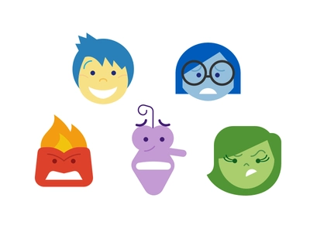
Classify different types of emotions based on human brain waves and eye movements.
Sad
Happy
Disgust
Neutral
Fear

Slide 5
Applications

Slide 6
01
02
Understanding Emotions
Diagnosis Purposes
Psychiatry and Psychology
Relationship between emotions, EEG and eye movement.
04
03
Affective Computing Technologies
Therapeutic Purposes
Evaluate treatments effectiveness
Human-computer interaction

Slide 7
SEED-V
Shanghai Jiao Tong University

Slide 8
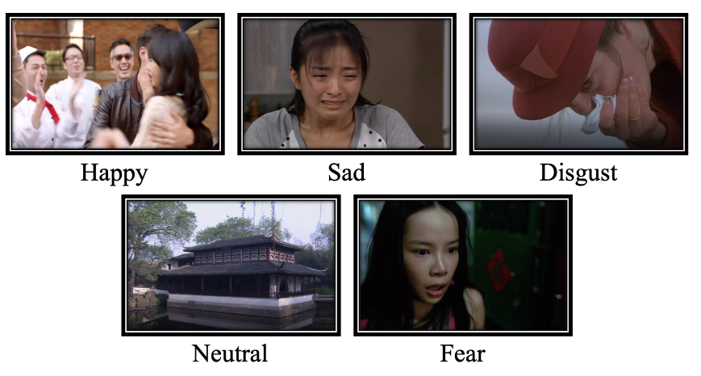
Important Data
EEG features
01
02
EEG_raw
Features of 16 participants
Data collected with Neuroscan device
Emotion label and stimuli order
04
03
Eye_raw
Experiments’ order
Blink duration, Average Pupil Size, etc.

Slide 9
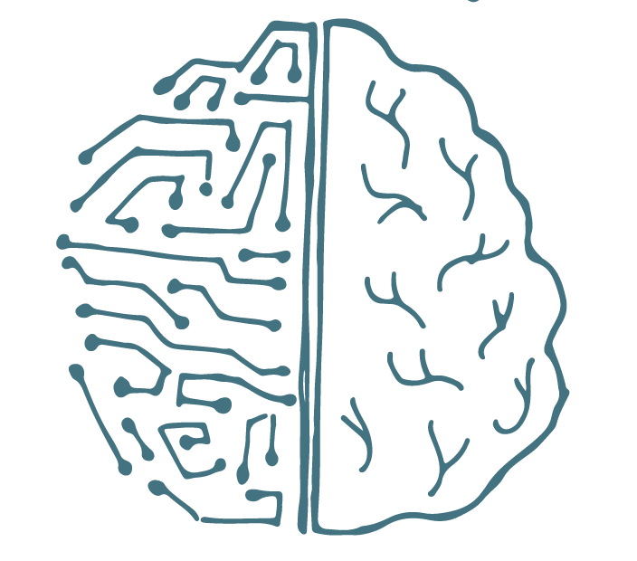
Architecture
(RNN type)

Slide 10
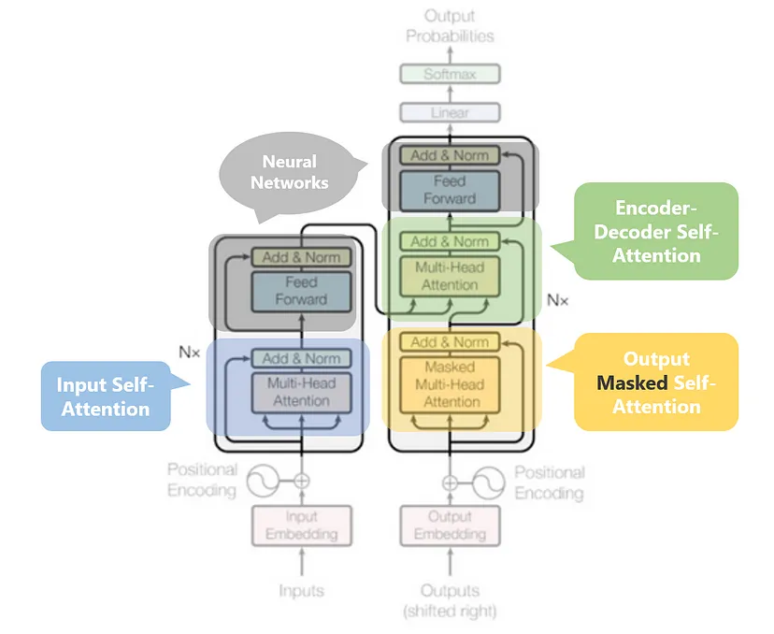
Transformers
Used primarily in the fields:
Natural Language Processing (NLP)
Computer Vision (CV)

Slide 11
Long Short-Term Memory (LSTM)
LSTM can process not only single data points (such as images), but also entire sequences of data (speech or video)

Slide 12
WaveNet
A Deep Generative model of raw audio waveforms.

Slide 13
Classification

Slide 14
